Slide 2
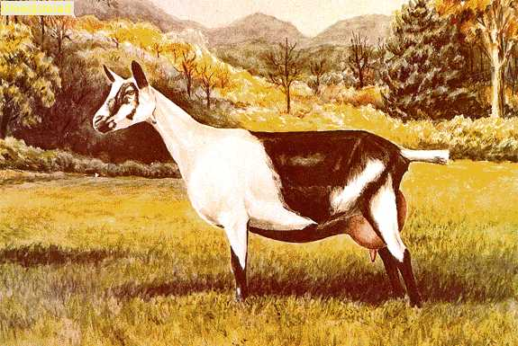
Alpine
Origin:
most numerous variety is the France Alpine
others include the British (please see category on British Alpine), Rock and Swiss
Characteristics:
medium to large sized breed
short to medium hair coat in all colors and color combinations; breed discriminates against Toggenburg and pure white
unique upright ears and a straight face with roman nose
known for both gratefulness and hardiness
Usage:
extremely adaptable dairy goat
maintains both excellent milk production and health in stressful climates

Slide 3
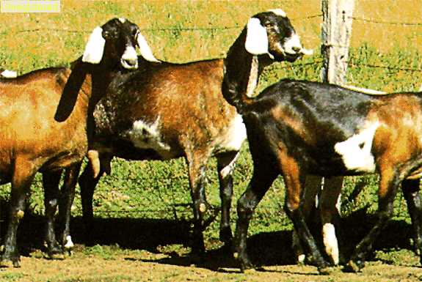
Anglo- Nubian
Origin:
England; developed using bucks of African and Indian origin and crossing them with British does
was introduced to the U.S. and Australia in the 1950s
Characteristics:
large goat with short, sleek hair and comes in a variety of colors
has very large drooping ears and a roman nose
generally polled
Usage:
used for meat, hide and milk; milks less than the Swiss breeds and has a shorter lactation period, but a higher milk fat content (4-5 percent)
has a larger breeding season than Swiss breeds, therefore can produce milk year-round
well suited to hot climates and has been used to upgrade breeding programs in tropical climates

Slide 4
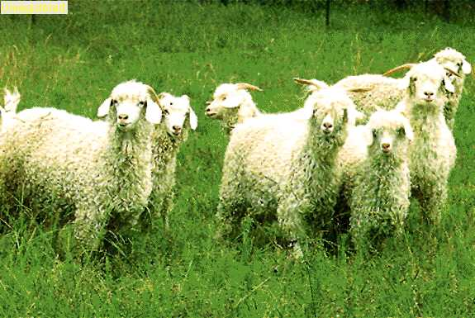
Angora
Origin:
Turkey
introduced to Australia from France in the 1830s
in the early 1900s, Merino wool gained popularity resulting in a decline
was brought back in favor with producers in the 1970s
Characteristics:
white with pink skin and long curly hair which stops at the knee; faces have short white hair; horned
Usage:
used for the production of mohair, the fiber or hair of the goat; it is long, soft and strong with a shiny appearance
mechanically shorn two times per year; an adult produces on the average 3.5 kg of mohair per year

Slide 5
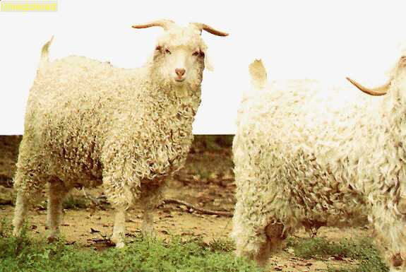
Australian Goat
Origin:
has been present in Australia since the turn of the century
became prolific when flocks were abandoned due to drought or lack of profit and slowly built up from escapees of shepherded flocks
Characteristics:
environmentally adapted due to its need to survive in the wild
has been noted for its strong fiber and milk producing ability
Usage:
used for meat production and as a base for developing cashmere, mohair and leather
used as recipients in ovum transplant programs
in mixed herd management to control weeds and brush in sheep herds

Slide 6
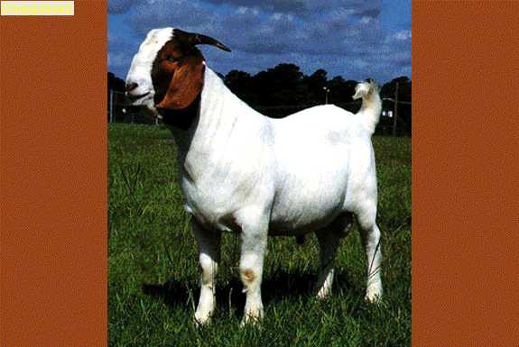
Boer Goat
Origin:
unknown
Characteristics:
low maintenance and hardy
well adapted to harsh conditions.
generally have a white body and red head ranging from light brown to dark red
pigmentation suited to withstand brusque conditions
Usage:
true meat goat
weaning rates are more than 160 percent
has been managed with cattle due to its browsing ability and low impact on grass

Slide 7
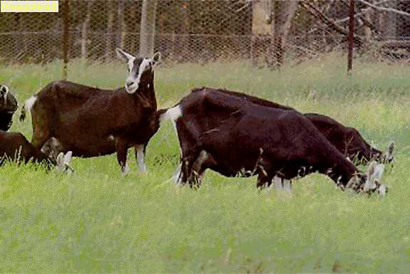
British Alpine
Origin:
England; breed was developed in the early 1900s
Characteristics:
large and black with distinctive white markings
has white facial stripes which start above the eyes and end at the muzzle and also white markings on the outside of the ears, on the inside and outside of the legs which extends to the trunk and under the base of the tail
ears are erect and it is polled
buck generally has a longer hair coat than the doe
Usage:
used mainly as a dairy goat; moderate to heavy milk producer known for its winter milking ability and extended lactation period
It fairs best in temperate climates

Slide 8
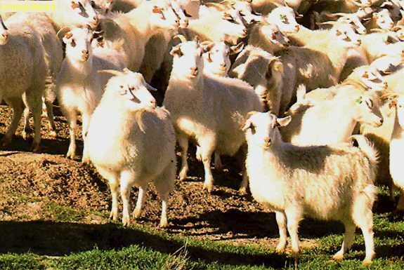
Cashmere
Origin:
India; named after the Indian state of Cashmere
can be found naturally in Mongolia, Tibet, Northern India and Western China
were imported to the U. S. in 1990
Characteristics:
hardy with many feral flocks still roaming in the areas mentioned
is horned and sheds its warm coat in the spring
Usage:
produce one of the world's finest fibers – cashmere
undercoat is downy soft, warm and light; is used to produce clothing; fibers vary from brown to light gray to white; white brings a considerable premium
sheared once a year; adults produce, on average, 2 to 2 1/2 lbs. of fleece per year

Slide 9
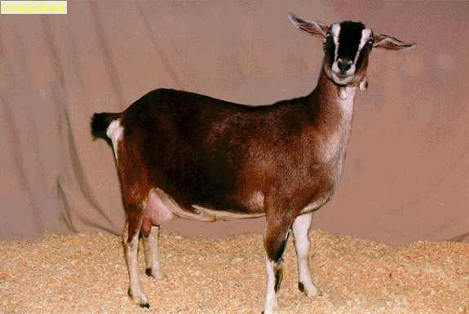
Kinder
Origin:
United States
developed in Washington in 1985 on Zederkamm Farm using two Nubian does and a Pygmy buck; in 1988 the Kinder Goat Breeders Association (KGBA) was developed
Characteristics:
moderate size
hardy and highly efficient goat known for its docile nature
Usage:
dual purpose breed producing both milk and meat
whethers are good meat animals with rapid growth rates and high dressing percent
known for its multiple births with triplets and quads being routine; quintuplets and sextuplets are common

Slide 10
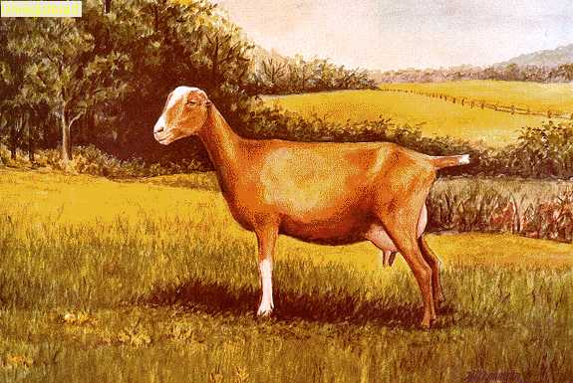
LaMancha
Origin:
United States, Oregon
Characteristics:
has a straight face with distinctive ears
within the breed there are two types ears: the 'gopher ear' which is essentially non-existent with very little cartilage, but must be up to one inch in order to be registered; the other type of ear is termed 'elf ear‘; also must have the ends turned up or down, yet can be a maximum of two inches and can have cartilage shaping
has a short glossy fine hair coat which is acceptable in any color or color combination
Usage:
hardy dairy goat with an agreeable temperament
has high milk production with a high butterfat content

Slide 11
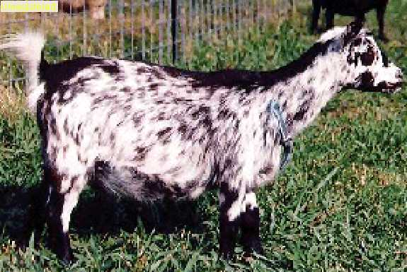
Nigerian Dwarf
Origin:
West Africa
Characteristics:
miniature with well-balanced dairy goat conformation
has soft, short to medium length hair which can be any color or color combination, however silver agouti (roan) is undesirable
has a straight nose and upright ears
gentle breed and require adequate fencing to contain due to smaller size, but can be managed the same as a other herds
Usage:
mainly a show or pet goat, however, are also noted for their milk production
early to sexually mature and commonly produce three to four and even five offspring at a time

Slide 12
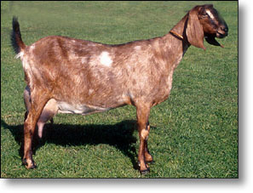
Nubian
Origin:
oriental origin
Characteristics:
distinguished by its strongly convex facial profile
has long wide ears which extend at least an inch beyond the muzzle and lie close to the head at the temple, but slightly flair out at the rounded tip and form a 'bell' shape
coat is acceptable in any color, or color combinations/patterns and is short, fine and glossy
Usage:
dairy goat known for its milk which is high in production, quality and butterfat

Slide 13
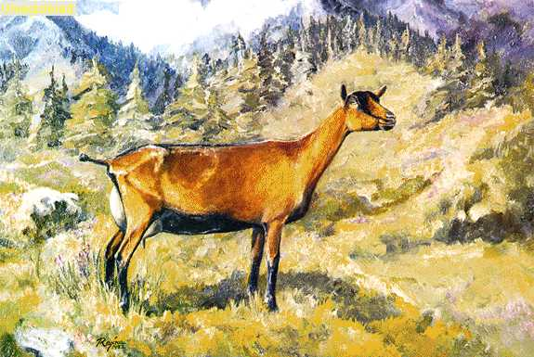
Oberhasli
Origin:
Switzerland
Characteristics:
medium in size with a straight face
both vigorous and alert by nature
color is preferably Chomois (a light to deep red bay), although does may be black
markings include two black stripes down the face, black forehead, black dorsal stripe, black points and black belly; bucks often have more black on the face than does have
both sexes may have a few white hairs through out the coat, however bucks usually have more white than does
Usage:
dairy goat

Slide 14
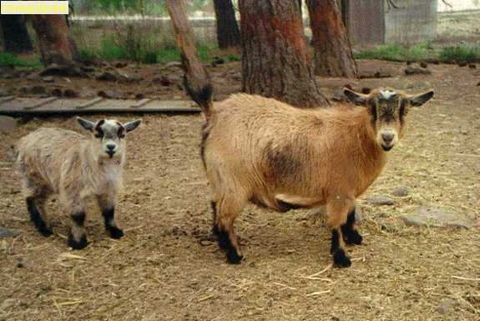
Pygmy Goat
Origin:
French Cameroon area
arrived in the United States in 1959 from from Sweden
Characteristics:
have a variety of acceptable colors; predominant pattern is agouti which is intermingled light and dark hairs of any color
required makings include: muzzle, forehead, eyes and ears with a lighter tone than the body, front and rear hooves and cannons darker than the body, and also must have a darker crown and dorsal stripe; not required on the solid black; caramel shades must have light vertical stripes on front sides of darker socks
have a full, straight hair coat of medium to long length; both males and females have beards
Usage:
mainly a show or pet goat

Slide 15
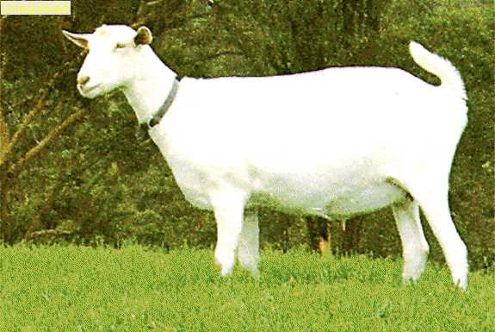
Saanen
Origin:
Switzerland; named after the Saane Valley of Switzerland
were brought into Australia, yet the breed registry was founded in 1913 by the New South Wales Department of Agriculture
Characteristics:
large in size
hair coat is generally short, fine textured and white or creamy colored, however, white is preferable
skin may have spots, yet is not desired to have hair color spots
have alert, erect ears and a straight or slightly dished nose
Usage:
used as a dairy goat; has great milking ability and produces milk with a milk fat content between 3 and 4 percent; is the most widely available dairy breed
responds best in a cooler environment

Slide 16
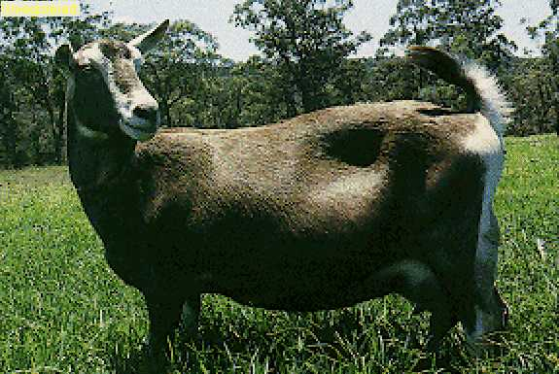
Toggenburg
Origin:
Toggenburg Valley of Switzerland; oldest known dairy goat breed
Characteristics:
smaller in size than the Saanen, but stockier in build
hair coat is short or medium in length and has a soft fine texture
are various shades of solid brown ranging from light fawn to dark chocolate; markings include white lining in ears, two white facial stripes: one above each eye traveling down to the muzzle, white hind legs from the knee down and a white triangle at each side of the tail base
faces are straight or dished with erect ears
Usage:
used as a dairy goat
assets include: excellent udder development, persistent lactation, high milk production and a milk fat of 3.7 percent
better adapted to cooler climates

Slide 17
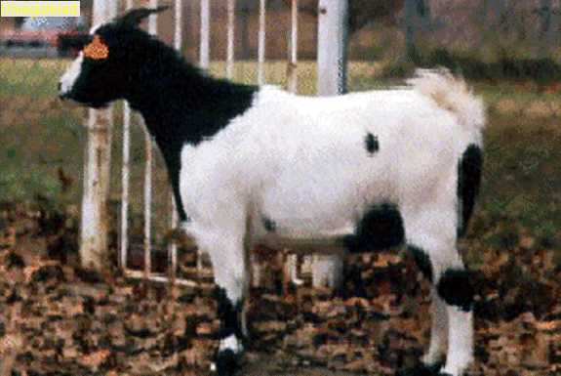
Wooden Leg
Origin:
unknown, but indigenous to the United States and mostly found in Tennessee and Texas
breed has an estimated population of 10,000 and has been put on the ‘rare’ list by the American Livestock Breed Conservancy
Characteristics:
usually black and white, but can be multi-colored
have good maternal traits such as birthing ease and heavy milkers; breed seasonally and often produce twins
myotonic response is from lacking the parasympathetic ‘fight/flight’ response, so when they become frightened or excited they simply ‘lock up’ and faint
Usage:
mainly a meat goat, but also marketed as pets
people are fascinated by their unique fainting; has been suggested to crossbreed to the Boer, but fainting gene is recessive, and therefore is not usually expressed when crossbred

Slide 18
Assessment

Slide 19
Assessment
1. Which of the following breeds is used for the production of Mohair?
A. Cashmere
B. Alpine
C. Angora
D. Boer Goat
2. Where did the Boer Goat originate?
A. Australia
B. The Boer Goat’s origin is unknown
C. Switzerland
D. Turkey

Slide 20
Assessment
3. What is the primary usage of the Cashmere breed?
A. It is a dairy breed.
B. It is a meat breed.
C. It produces cashmere, one of the world’s finest fibers
D. It is a pet goat.
4. What is the primary usage of the Pygmy Goat?
A. It is a pet or show goat.
B. It is used for its mohair production.
C. It is used in crossbreeding operations.
D. It is a dairy goat.

Slide 21
Assessment
5. What does the Wooden Leg Goat do as a response to becoming frightened or excited?
A. It fights back by head-butting its opponent.
B. It runs away.
C. It begins to bleat uncontrollably.
D. It ‘locks up’ and faints.
6. Where did the Nigerian Dwarf originate?
A. Russia
B. East Europe
C. Asia
D. West Africa

Slide 22
Assessment
7. Which breed is known for its multiple births with triplets and quads being routine, but quintuplets and sextuplets also being common?
A. Kinder
B. Alpine
C. Pygmy
D. Oberhasli
8. Which goat is a true meat goat?
A. Cashmere
B. Nubian
C. Toggenburg
D. Boer Goat

Slide 23
Assessment
9. Which breed was developed using bucks of African and Indian origin and crossing them with British does?
A. Toggenburg
B. Wooden Leg
C. Anglo-Nubian
D. Saanen
10. Which breed became prolific when flocks were abandoned due to drought or lack of profit and slowly built up from escapees of shepherd flocks?
A. Angora
B. Australian Goat
C. British Alpine
D. LaMancha

Slide 24
Acknowledgments
Production Coordinators
Daniel Johnson
Jessica Odom
Graphic Designer
Daniel Johnson
Technical Writer
Jessica Odom
V.P. of Brand Management
Clayton Franklin
Executive Producer
Gordon W. Davis, Ph.D.
© MMXIV
CEV Multimedia, Ltd.

